Slide 1
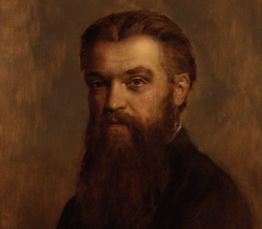
Geometric Algebra
8. Unification and Implementation
Dr Chris Doran
ARM Research

Slide 2


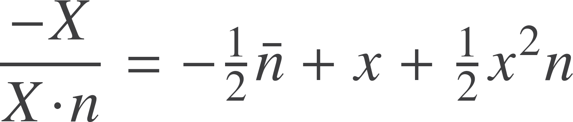
Euclidean geometry
Represent the Euclidean point x by null vectors
Distance is given by the inner product
Read off the Euclidean vector
Depends on the concept of the origin

Slide 3
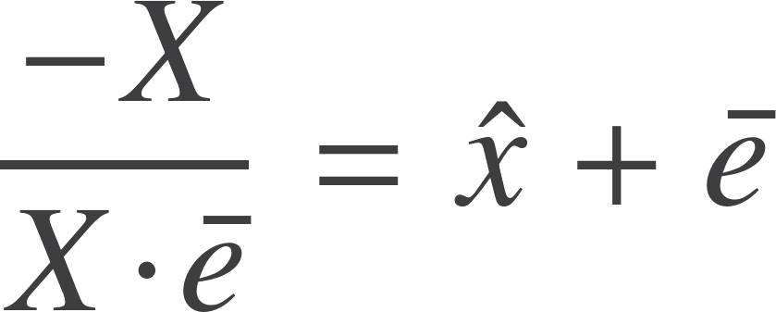
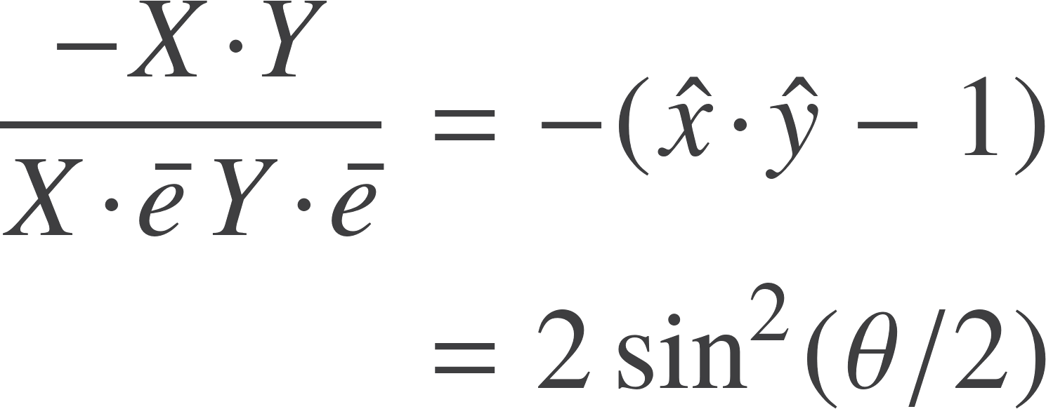
Spherical geometry
Suppose instead we form
Unit vector in an n+1 dimensional space
Instead of plotting points in Euclidean space, we can plot them on a sphere
No need to pick out a preferred origin any more

Slide 4
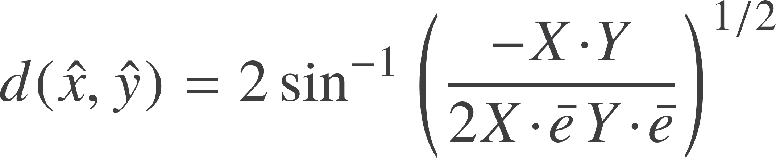




Spherical geometry
Spherical distance
Same pattern as Euclidean case
‘Straight’ lines are now
Invariance group are the set of rotors satisfying
Generators satisfy
The term now becomes essentially redundant and drops out of calculations
Left with standard rotors in a Euclidean space. Just rotate the unit sphere

Slide 5
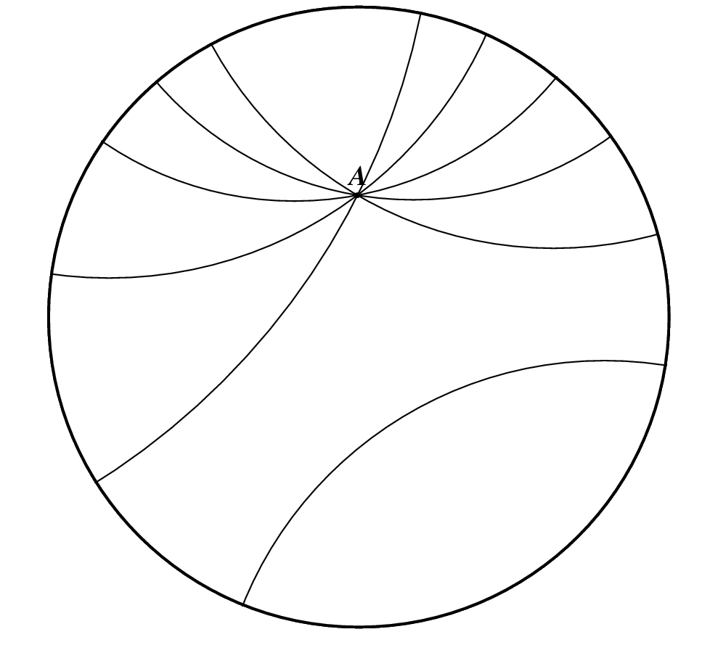





non-Euclidean geometry
Historically arrived at by replacing the parallel postulate
‘Straight’ lines become d-lines. Intersect the unit circle at 90º
Model this in our conformal framework
Unit circle
d-lines
d-line between X and Y is
Translation along a d-line generated by
Rotor generates hyperbolic transformations

Slide 6
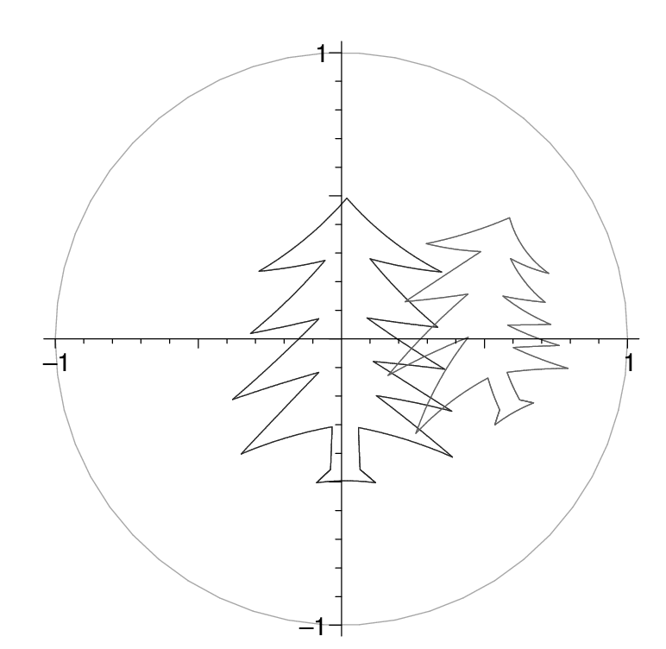
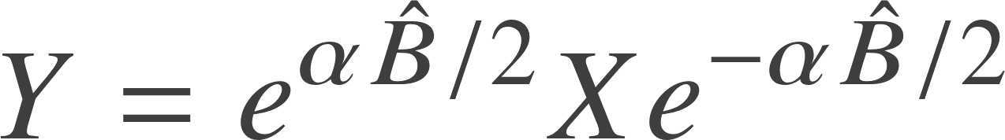
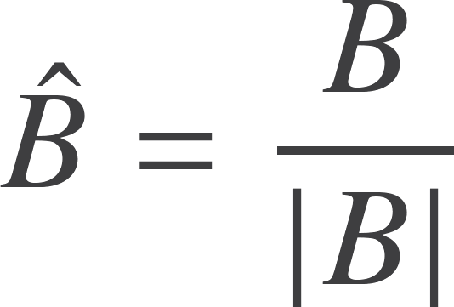
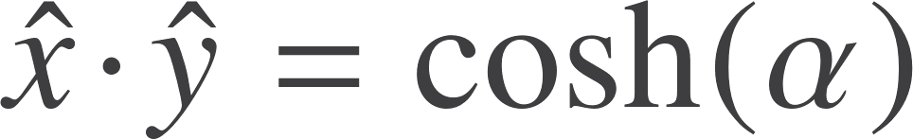
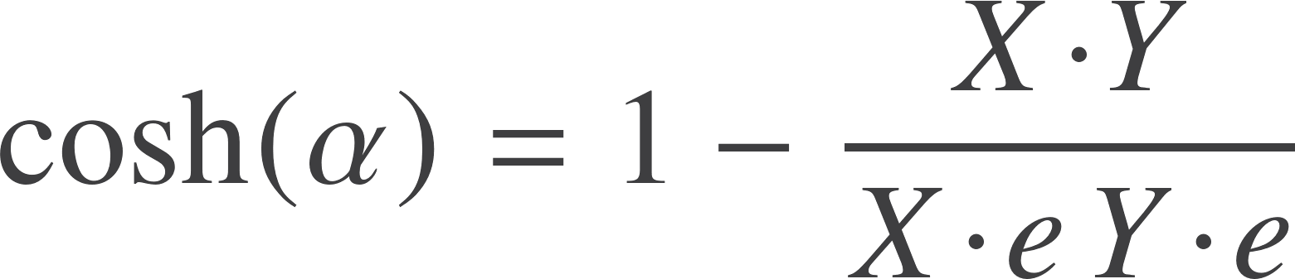

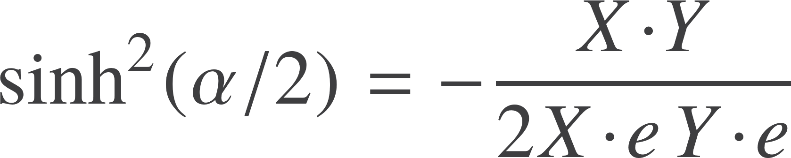
non-Euclidean geometry
Generator of translation along the d-line. Use this to define distance.
Write
Unit time-like vectors
Boost factor from special relativity
Distance in non-Euclidean geometry

Slide 7
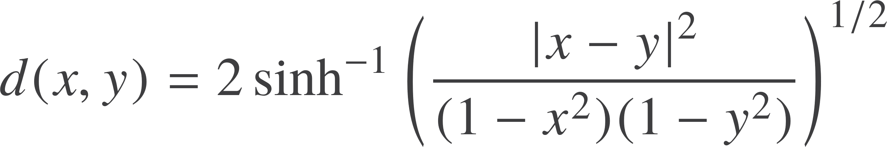
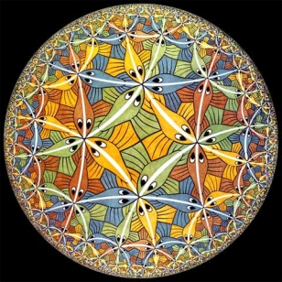
non-Euclidean distance
Distance expands as you get near to the boundary
Circle represents a set of points at infinity
This is the Poincare disk view of non-Euclidean geometry

Slide 8
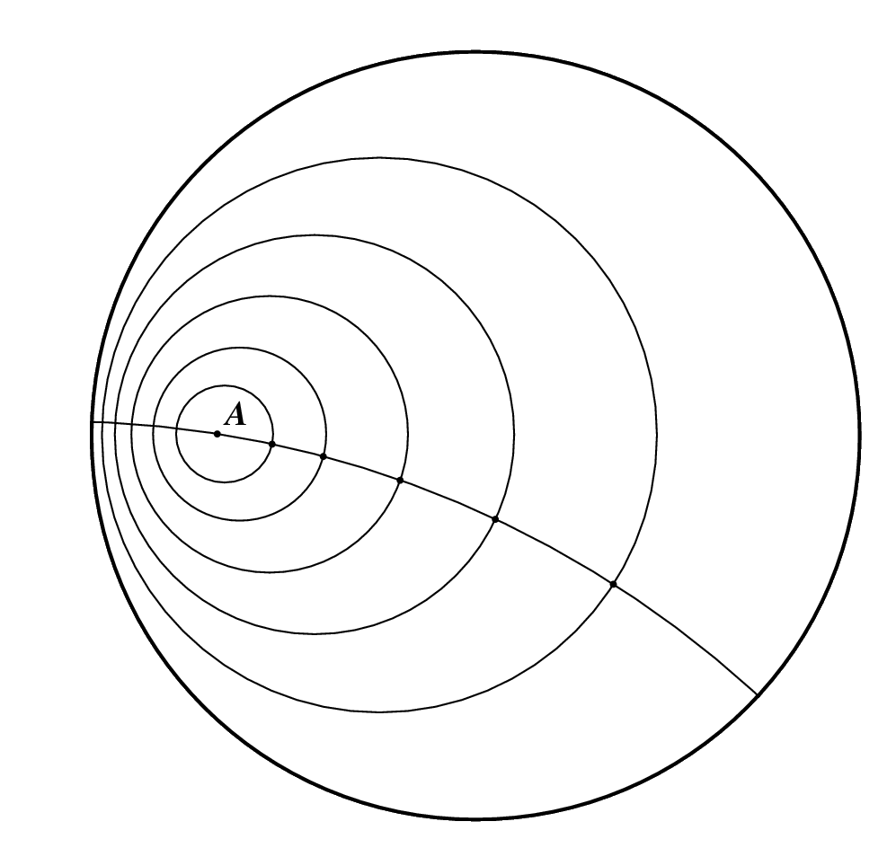
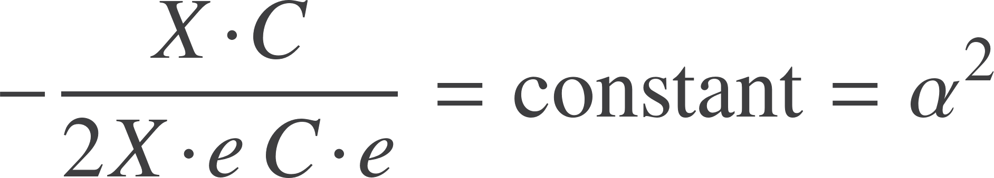
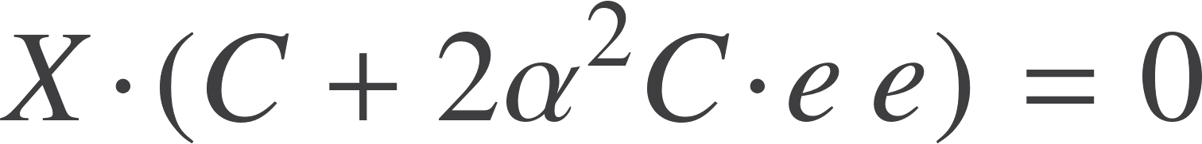


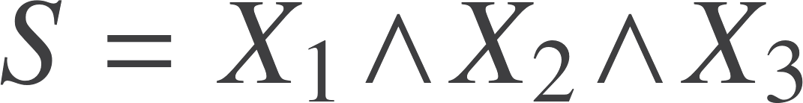



non-Euclidean circles
Formula unchanged from the Euclidean case
Still have
Non-Euclidean circle
Definition of the centre is not so obvious. Euclidean centre is
Reverse the logic above and define

Slide 9
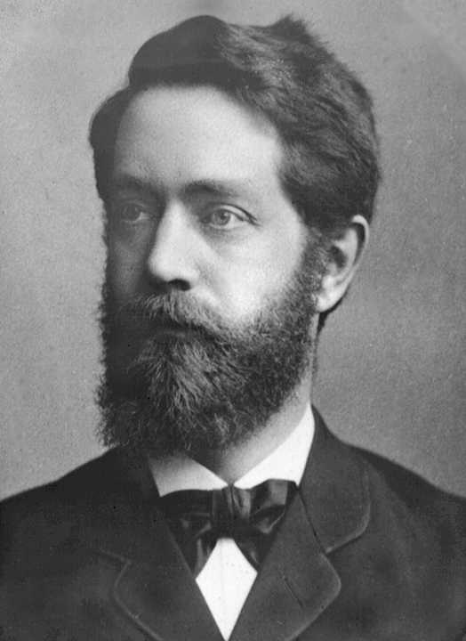
Unification
Conformal GA unifies Euclidean, projective, spherical, and hyperbolic geometries in a single compact framework.

Slide 10
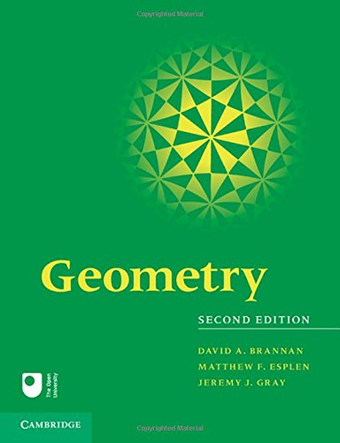


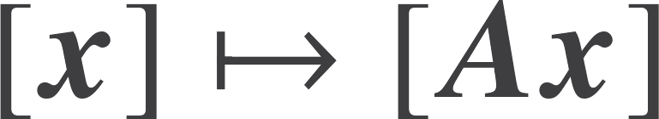

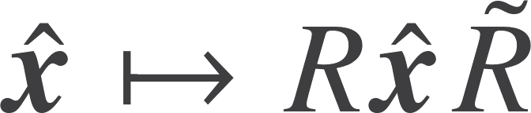

Geometries and Klein
Understand geometries in terms of the underlying transformation groups
Euclidean
Affine
Projective
Conformal
Mobius /Inversive
Spherical
non-Euclidean

Slide 11
Geometries and Klein
Projective viewpoint
Conformal viewpoint
Euclidean
Euclidean
Affine
Spherical
Projective
non-Euclidean
Conformal
Conformal
Euclidean
Affine

Slide 12




Groups
Have seen that we can perform dilations with rotors
Every linear transformation is rotation + dilation + rotation via SVD
Trick is to double size of space
Null basis
Define bivector
Construct group from constraint
Keeps null spaces separate. Within null space give general linear group.

Slide 13
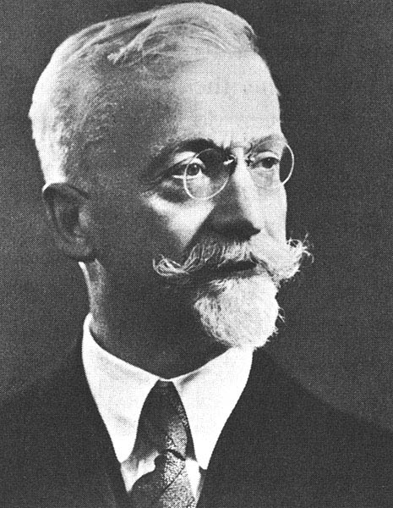
Unification
Every matrix group can be realised as a rotor group in some suitable space. There is often more than one way to do this.

Slide 14
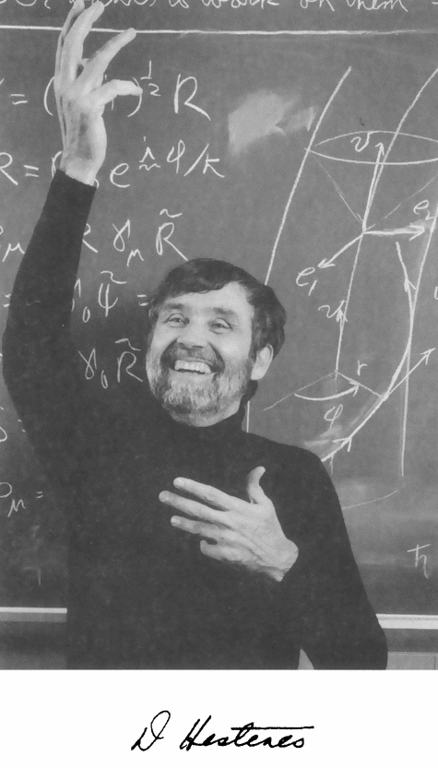
Design of mathematics
Coordinate geometry
Complex analysis
Vector calculus
Tensor analysis
Matrix algebra
Lie groups
Lie algebras
Spinors
Gauge theory
Grassmann algebra
Differential forms
Berezin calculus
Twistors
Quaternions
Octonions
Pauli operators
Dirac theory
Gravity…

Slide 15



Spinors and twistors
Spin matrices act on 2-component wavefunctions
These are spinors
Very similar to qubits
Roger Penrose has put forward a philosophy that spinors are more fundamental than spacetime
Start with 2-spinors and build everything up from there

Slide 16
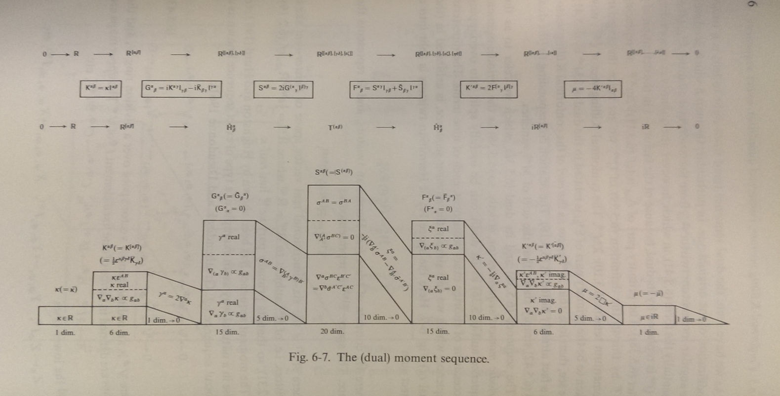
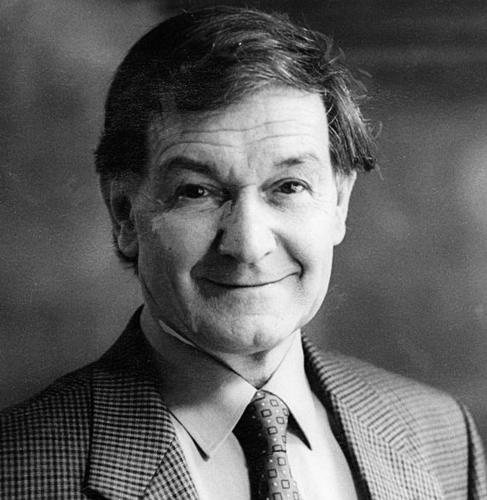
Twistors
Look at dimensionality of objects in twistor space
Conformal GA of spacetime!

Slide 17
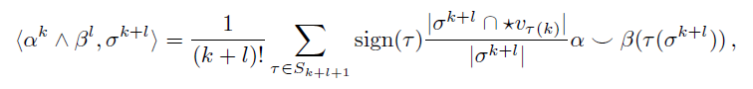
Forms and exterior calculus
Working with just the exterior product, exterior differential and duality recovers the language of forms
Motivation is that this is the ‘non-metric’ part of the geometric product
Interesting development to track is the subject of discrete exterior calculus
This has a discrete exterior product
Challenge – can you do better?
This is associative! Hard to prove.

Slide 18
Implementation
What is the appropriate data structure?
How do we implement the geometric product
Programming languages

Slide 19
Large array
Type: [Float]
Vectors in 3D
Bivector in 4D
For
Against
Arrays are a compact data structure – hardware friendly
Objects are fairly strongly typed
Do not need a separate multiplication matrix for each type
Very verbose and wasteful
Need to know the dimension of the space up front
Hard to move between dimensions
Need a separate implementation of the product for each dimension and signature

Slide 20


Compact array
Type: [Float]
Vectors in 3D
Bivector in 3D
For
Against
Arrays are a compact data structure – hardware friendly
Most familiar
Difficult to imagine a more compact structure
Objects are no-longer typed
Need to know the dimension of the space up front
Hard to move between dimensions
Need a separate implementation of the product for each dimension and signature and grade.

Slide 21
Linked list
Type: [(Float,Int)] or [(Blade)]
Vectors in 3D
As a linked list
(a1,1):(a2,2):(a3,8):[]
For
Against
Strongly typed
Sparse
Only need to know how to multiply blade elements together
Multiplication is a map operator
Don’t need to know dimension of space…
Linked-lists are not always optimal
Depends how good the compiler is at converting lists to arrays
Need a look-up table to store blade products

Slide 22
Linked list
Details depend on whether you want to use mixed signature space
Best to stay as general as possible
Blade | Binary | Integer
1 | 0 | 0
e1 | 1 | 1
f1 | 10 | 2
e2 | 100 | 4
f2 | 1000 | 8
e1f1 | 11 | 3
e1e2 | 101 | 5
Geometric product is an xorr operation
Implement this in a look-up table
Have to take care of sign
Careful with typographical ordering

Slide 23
Blade product
bladeprod (a,n) (b,m) = (x,r)
where (fn,r) = bldprod n m
x = fn (a*b)
The bldprod function must
Convert integers to binary rep
Compute the xorr and convert back to base 10
Add up number of sign changes from anticommutation
Add up number of sign changes from signature
Compute overall sign and return this
Can all be put into a LUT
Or use memoization
Candidate for hardware acceleration

Slide 24

Geometric product
[Blades]
[Blades]
A*B=simplify([bladeprod(a,b) | a <- A, b <- B])
Form every combination of product from the two lists
Sort by grade and then integer order
Combine common entries
Build up everything from
Multivector product
Projection onto grade
Reverse
Use * for multivector product

Slide 25
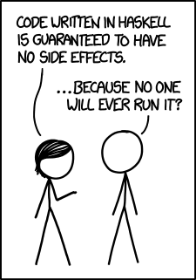
Why Haskell?
Functional
Functions are first-class citizens
The can be passed around like variables
Output of a function can be a function
Gives rise to the idea of higher-order functions
Functional languages are currently generating considerable interest:
Haskell, Scala, ML, OCaml …
Microsoft developing F#, and supporting Haskell
Immutable data
(Nearly) all data is immutable: never change a variable
Always create a new variable, then let garbage collector free up memory
No messing around with pointers!
Linked lists are the natural data type

Slide 26

Why Haskell?
Purity
Functions are pure
Always return same output for same input
No side-effects
Natural match for scientific computing
Evaluations are thread-safe
Strong typing
Haskell is strongly typed, and statically typed
All code is checked for type integrity before compilation
A lot of bugs are caught this way!
Strongly typed multivectors can remove ambiguity
Are 4 numbers a quaternion?
or a projective vector …
learnyouahaskell.com
haskell.org/platform
wiki.haskell.org

Slide 27
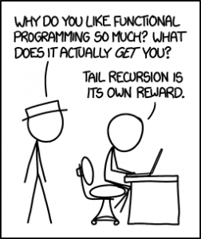

Why Haskell?
Recursion
Recursive definition of functions is compact and elegant
Supported by powerful pattern matching
Natural to mathematicians
Laziness
Haskell employs lazy evaluation – call by need
Avoids redundant computation
Good match for GA
Higher-level code
GA is a higher-level language for mathematics
High-level code that is clear, fast and many-core friendly
Code precisely mirrors the mathematics
“Programming in GA”

Slide 28
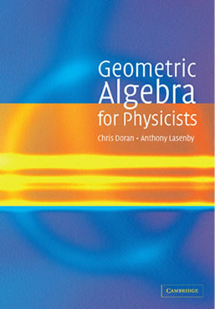
Resources
geometry.mrao.cam.ac.uk
chris.doran@arm.com
cjld1@cam.ac.uk
@chrisjldoran
#geometricalgebra
github.com/ga

